Slide 1
Image and Video Compression Laboratory
By Edward Wall and Nathan gibbs

Slide 2
Optimisation Techniques Implemented
Fast DCT
Log Search
Half PEL Accuracy
Group of Picture (GOP)
Timing and Huffman Table Optimisation
Intra Coding

Slide 3
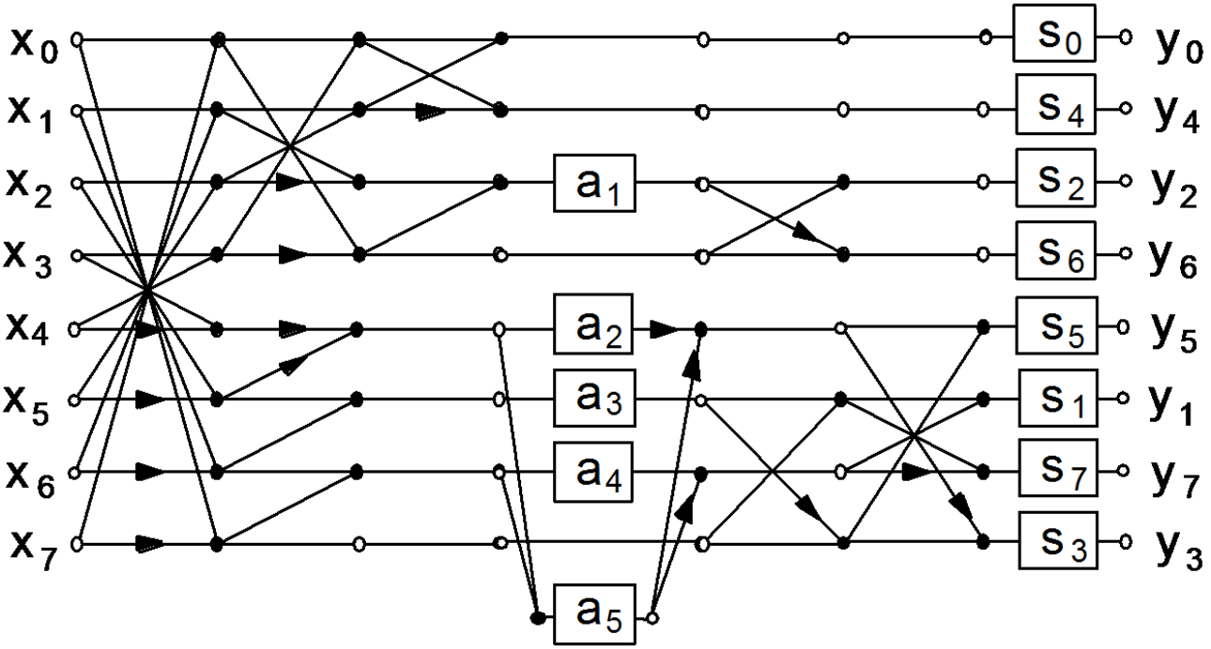
FAST DCT
Number of operation are reduced by eliminating redundant steps.
Computationally less complex
O(N log N) instead of O(N²)
Typically used for small fixed sizes over optimised FFT methods
≈20% Faster than block transform method.

Slide 4
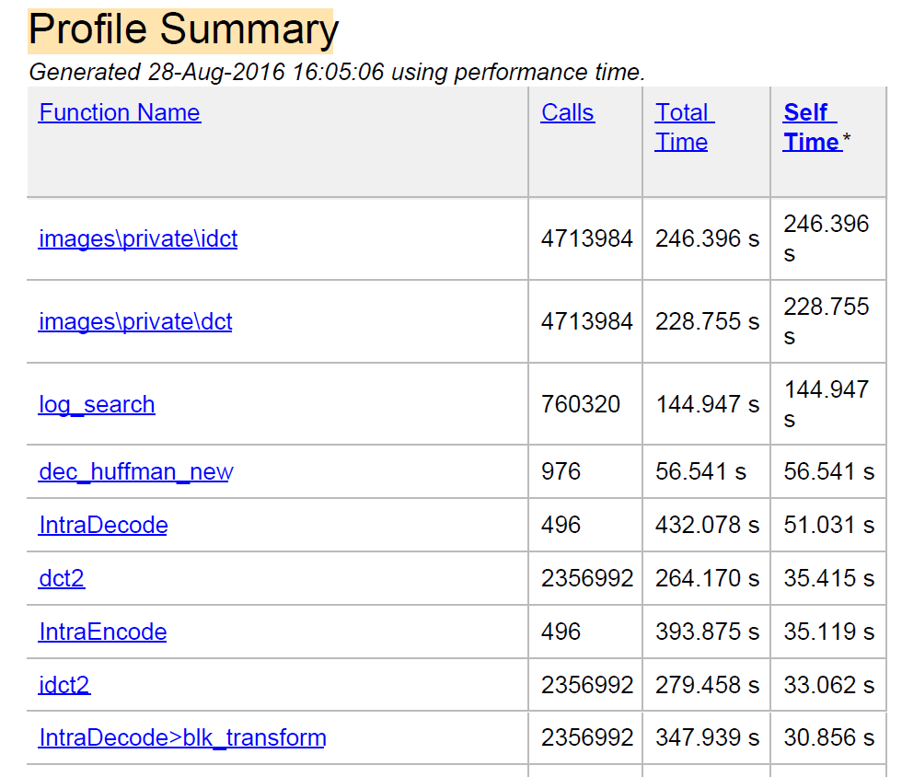

DCT Timing Comparisons
Matlab DCT function
Fast DCT Function

Slide 5
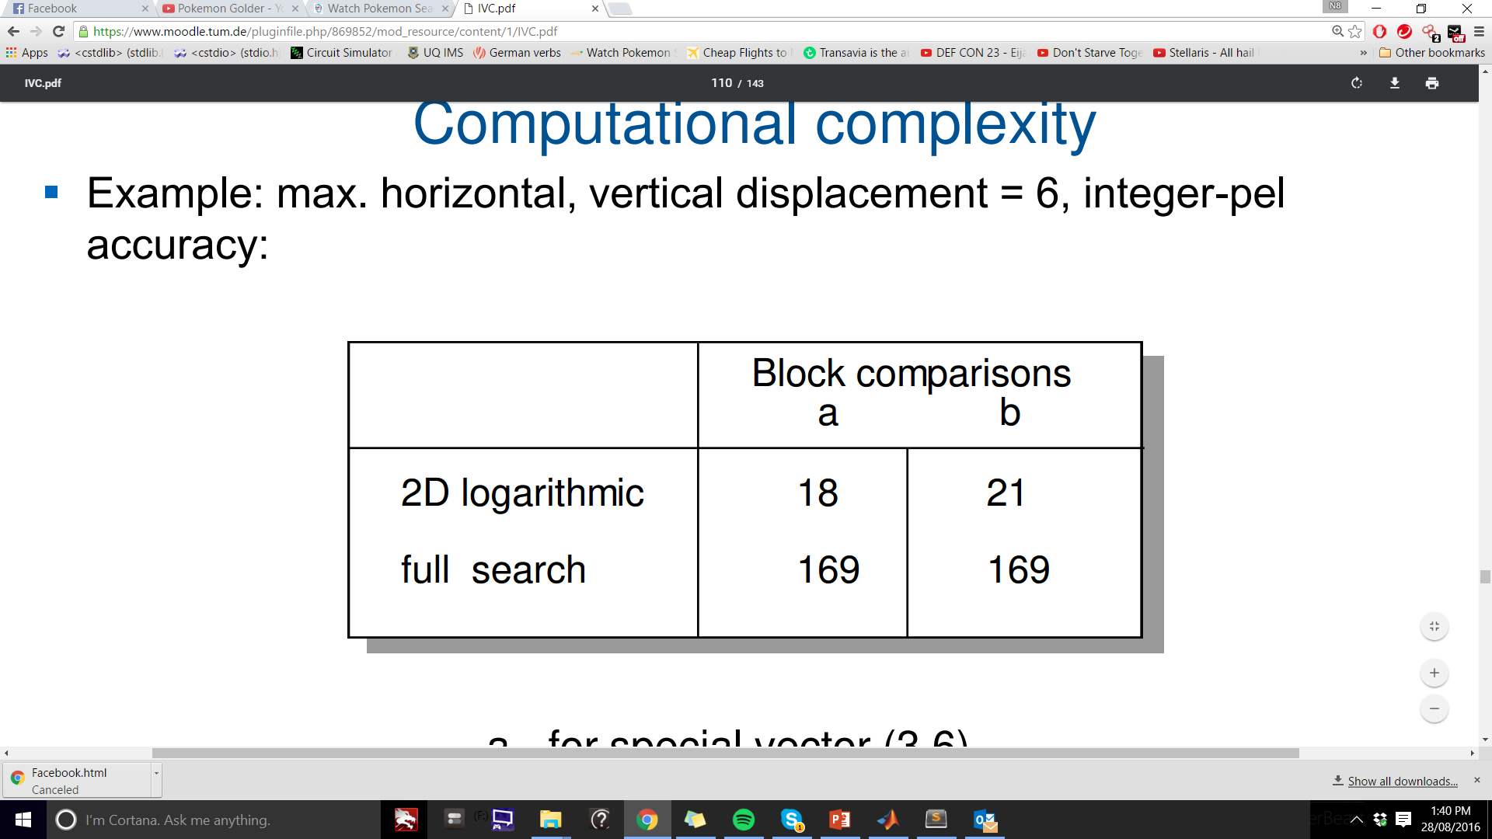
Log Search
Used to decrease the overall run time of the Video Codec.
Computes accurate motion vectors.
Compared to the Full search, Log search has less operations.
Example: Search Range = ±6 pixels and integer PEL accuracy.
Best Case: Worst Case:

Slide 6
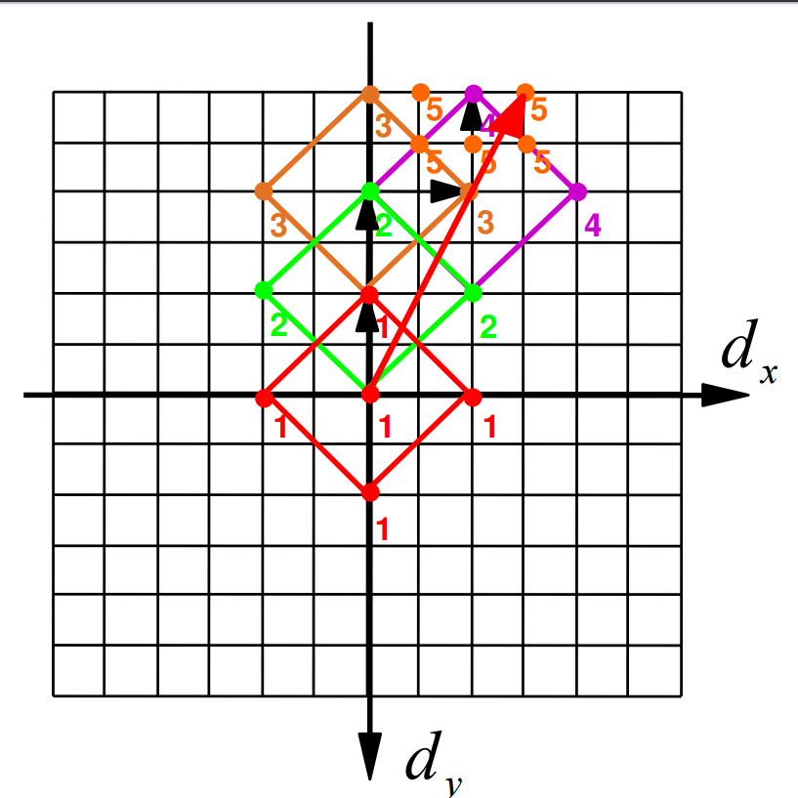
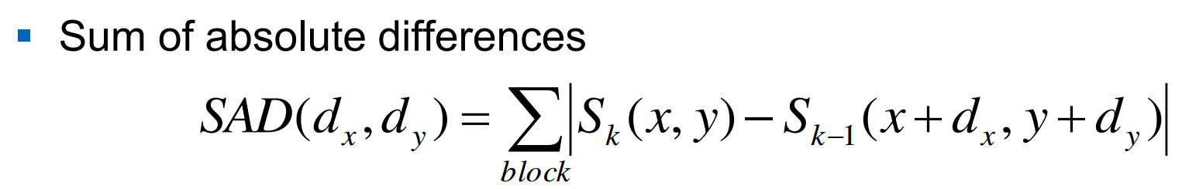
Log Search: How does it work?
Set a size for the diamond search pattern. (Usually ≈ 2)
Find the SAD of each point in the diamond
Choose the value with the lowest SAD and repeat process.
Refine search range when lowest SAD is the centre point.
If SAD is zero or cannot refine any further then end the search.

Slide 7
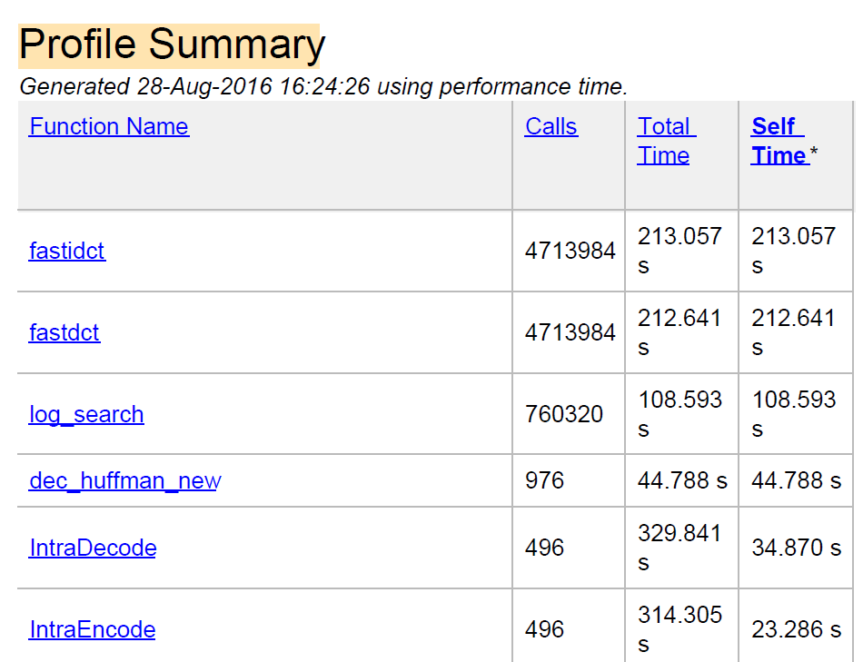
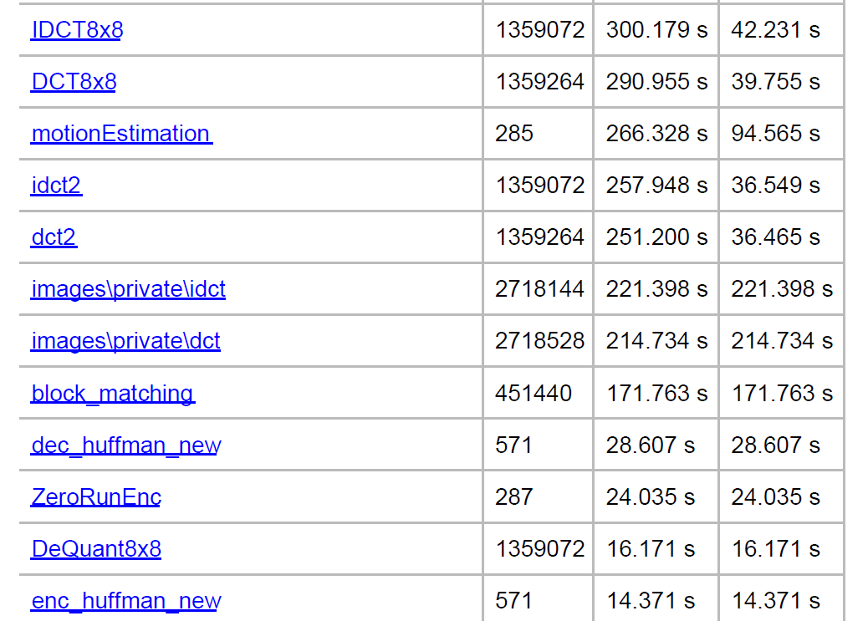
Time Comparison
Log Search
Full Search
Run Time per operation: 0.14ms
Run Time per operation: 0.38ms

Slide 8
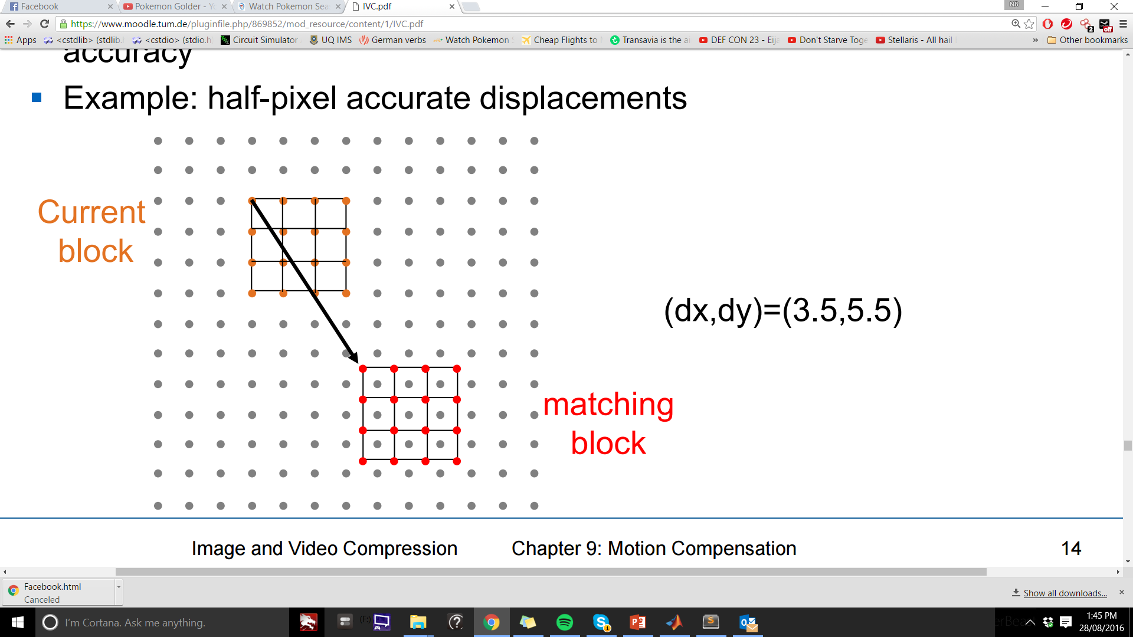
Half PEL Accuracy
Used in conjunction with Log Search algorithm.
Used as a final refinement stage.
Uses Bilinear interpolation to find fractional MV blocks.
Matlab Function: imresize with bilinear interpolation option

Slide 9
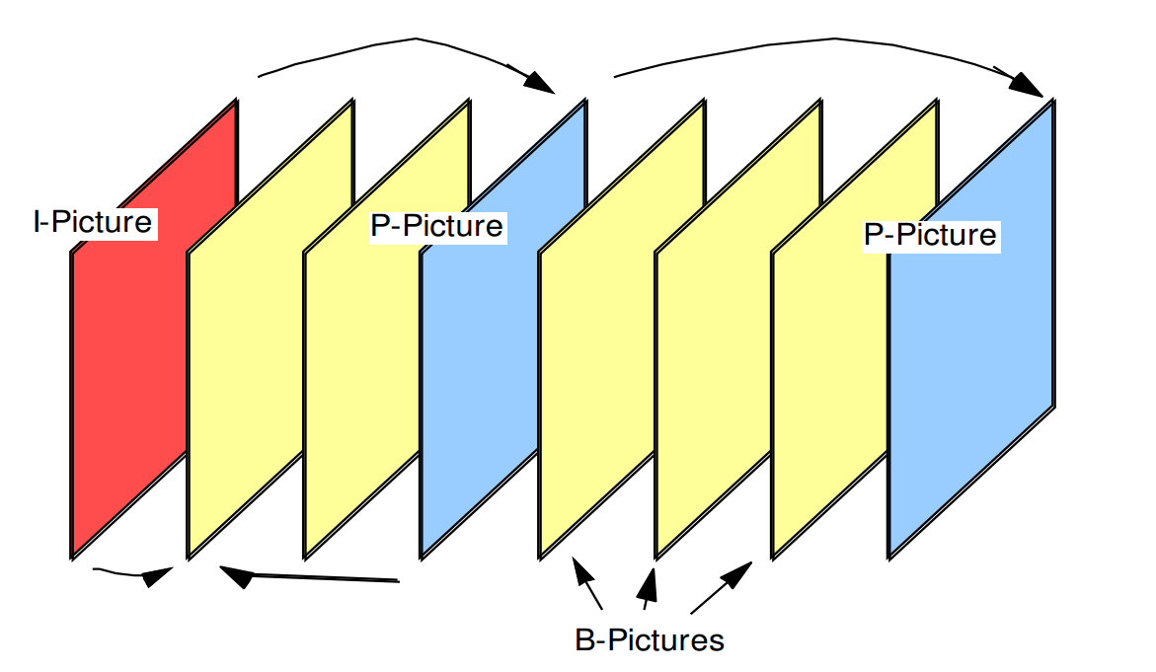
Group of Pictures
Used the MPEG GOP standard to allow the user to decrease the Code rate without decreasing the overall look of the video sequence.
Group of pictures constructed from:
I Frames – Encoded image no MV compensation
P Frames – Encoded MV based on previous P or I Frames
B Frames – Forward, Backward MV prediction or a combination of both

Slide 10
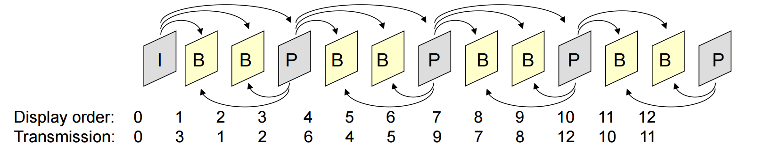
Current Implementation:
Implemented all three prediction methods of B frames, but the interpolated version was used.
B frames can have reduced code rate without severely effecting the overall look of the video sequence.
Sending order of frames has to be changed in order to decode B frames.

Slide 11
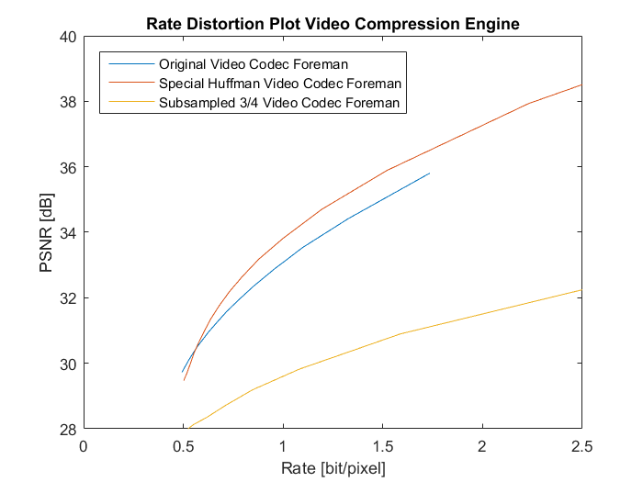
Rate Distortion Plot for GOP with Subsampled B frames:

Slide 12
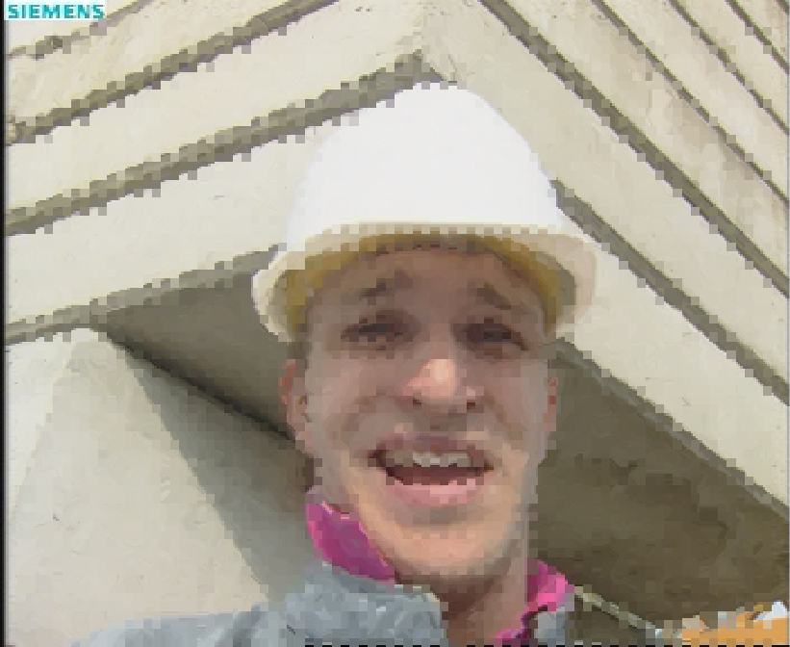
Intra Coding
Generally an image is broken into Macroblocks of 16x16.
These blocks are then broken into 8x8 and 4x4 blocks depending on complexity.
These blocks are then approximated and an error image is created and sent.

Slide 13
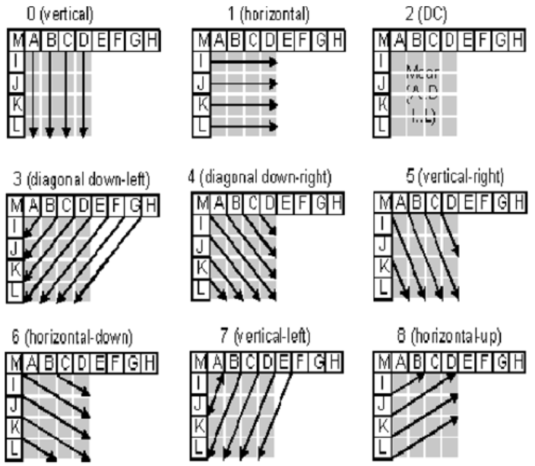
Intra Coding for 4 x 4 Blocks
First a prediction is made according to the mode that best matches the data.
This prediction is then subtracted from the current block.
The remainder is then encoded and sent with a number representing the mode.

Slide 14
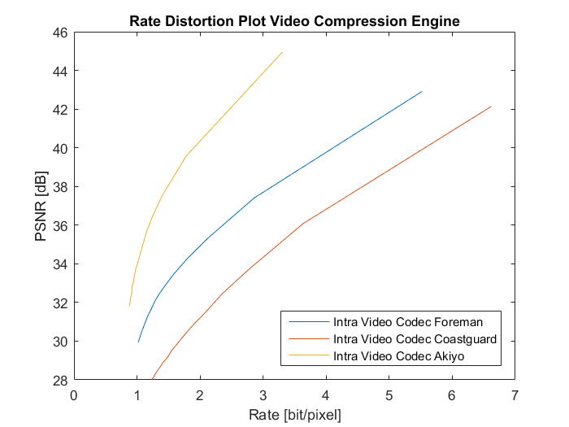
Rate Distortion Plot for Intra Coding across three test sequences:

Slide 15
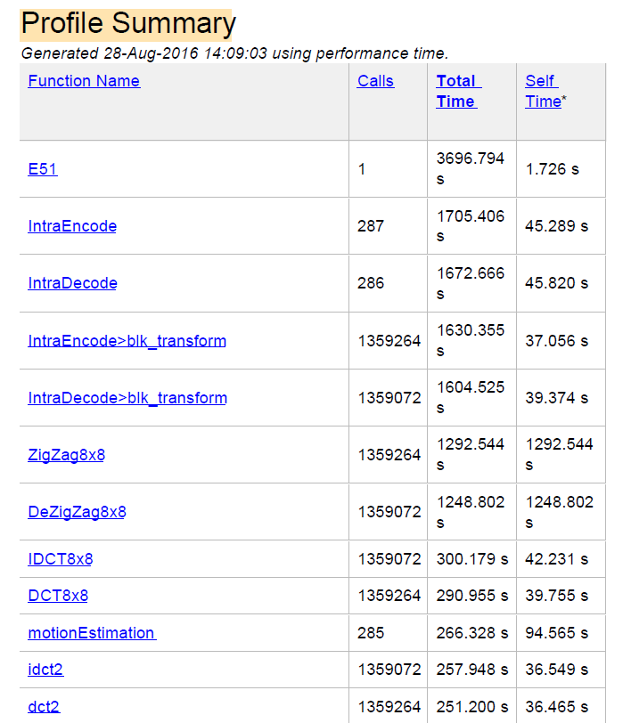
Timing Optimisations
Reduce function run-time
Zigzag function took a large amount of time. Optimised to reduced time.
DCT function was taking a considerable time as well. Fast DCT Implemented to reduce time.
Motion estimation took some considerable time, therefore log search was implemented to reduce time.

Slide 16

Huffman Table Optimisation
Individual tables are generated and used for each part of the data that is sent. These being
Still Image
Error Image from Movement Estimation
Movement Vectors
Tables generated using an average across distortion values

Slide 17
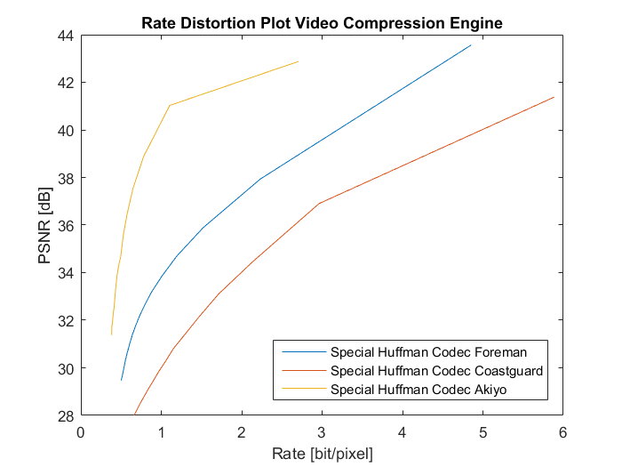
Rate Distortion Plot for Huffman Table Optimisation

Slide 18
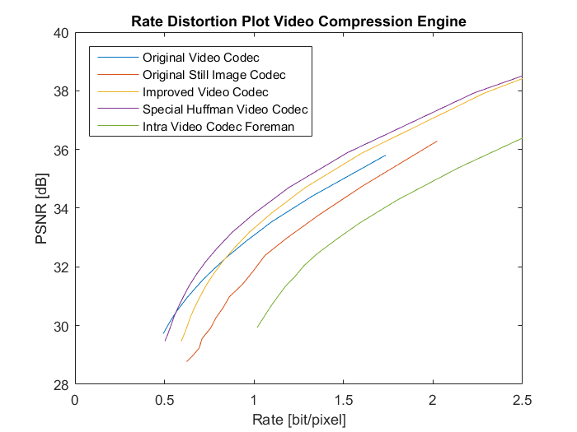
Implementation Comparisons:

Slide 19
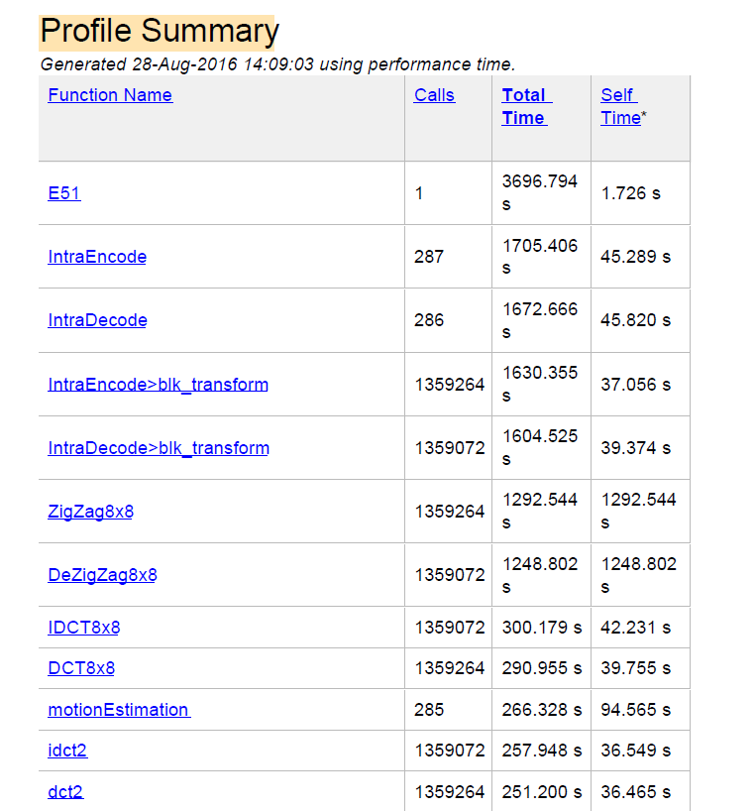
Run Time Comparison: Original Codec
Run time for the final video codec is 3696 secs (≈61mins)
Zigzag function contained a load function that consumed 1292 secs on encode and 1248 secs on decode.
With improved Zigzag ran for ≈19mins
Average Compression Time (non improved)
1705 secs (≈ 28mins)
Average Decompression Time non improved)
1672 secs (≈ 28mins)

Slide 20
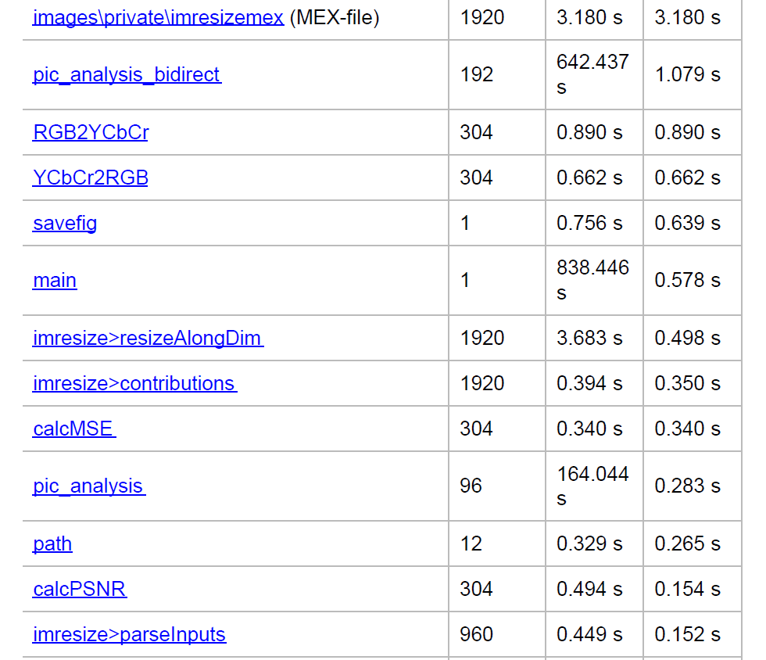
Run Time Comparison: Final Codec
Run time for the final video coded is 838 secs (≈14mins)
Average Compression Time
431 secs (≈ 7.2mins)
Average Decompression Time
336 secs (≈ 5.6mins)

Slide 21
Thank you for Listening

